Slide 1
CS 4530: Fundamentals of Software Engineering Module 1.2: User Stories
Adeel Bhutta and Mitch Wand
Khoury College of Computer Sciences
© 2026-27 Released under the CC BY-SA license

Slide 2
Learning Goals for this Lesson
At the end of this lesson, you should be able to
Explain the overall purposes of requirements analysis
Explain the connection between requirements analysis and user stories
Explain the structure of a user story
Identify and fix user stories that don’t have the correct structure
Define the relationship between conditions of satisfaction and user stories
Explain the difference between essential, desired, and extension levels of priority.
Explain the difference between functional and non-functional requirements, and give examples of each

Slide 3
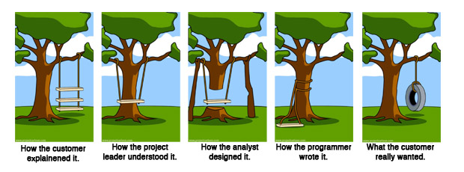
Requirement analysis helps in making sure that we are building the right thing
https://en.wikipedia.org/wiki/Tree_swing_cartoon
Notes:
Remember: the overall question for Requirements Analysis is making sure that we are building the right thing.
This meme does a great job capturing the many ways in which we can get off course and end up building the wrong thing. It may not be surprising that this meme dates back to at least the 1970’s, and long before the internet, was photocopied and hung up on the wall in many offices, particularly at software companies. These are not new problems: understanding what the customer wants the software to be, and then ensuring that we implement something that solves that problem is not easy.

Slide 4
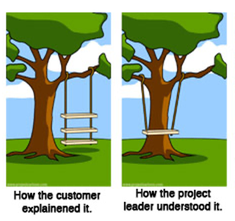
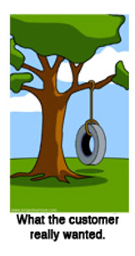
Why is requirements analysis hard?
Problems of understanding
Do users know what they want?
Do users know what we don’t know?
Do we know who are users even are?
Problems of scope
What are we building?
What non-functional quality attributes are included?
Problems of volatility
Changing requirements over time
4
Notes:
While getting the right requirements can certainly help make sure we build the right thing, it definitely doesn’t guarantee it.
Consider right now an example developing of a virtual meeting platform. With the start of the COVID-19 pandemic, and shift to virtual meetings, there has been an enormous demand for software to help substitute for physical events. But, even today, many platforms still don’t provide the experience that users want: how do you replace some physical interactions with a software product? These kind of challenges come up all of the time in software projects.
Sometimes, clients want to bring software in to solve some problem that is currently not being addressed, but don’t know exactly how to solve it. In other times, new software is brought in as a technology to improve an existing process. There is a way that things are done, and your software is going to help that get done better. In those situations, the client may simply not know what will work best for them.
Software engineering aims to provide answers, or at least a framework for answers to these questions
<Read slide. Possible elaboration:>
Examples of problems of understanding corresponding to the bullets:
What they want? -> Simply don’t know what is possible, won’t know it until they see it, often know what the problem is that they want the software to solve, but not the solution. Coming up with the solution is a design problem. Good to have a buddy who is a user experience designer.
What we don’t know? -> Most software is not “general purpose”, but exists within some domain.
Who are our users? -> Maybe most common in startups, where you have a client (moneybags investors) who are guessing who your users will be and what they want
Scope - What are we building? -> How to agree with client on a statement of work that is feasible given constraints, how to make sure that we stay on track?
Scope – quality attributes -> How to specify things like performance, usability, maintainability, security, etc
Volatility -> Long projects are subject to changes in world around them

Slide 5
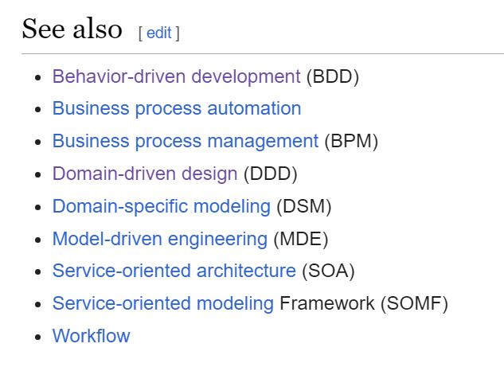
How do we capture the requirements?
There are many frameworks for capturing requirements.
Often described as x-Driven Design (for some x)
They differ in scope & details, but they have many features in common.
Notes:
In this lesson, we'll primarily be concerned with problems of understanding. How do we get from a customer's vague notions of what they might want to something concrete enough to guide us to build it.
<read slide>

Slide 6
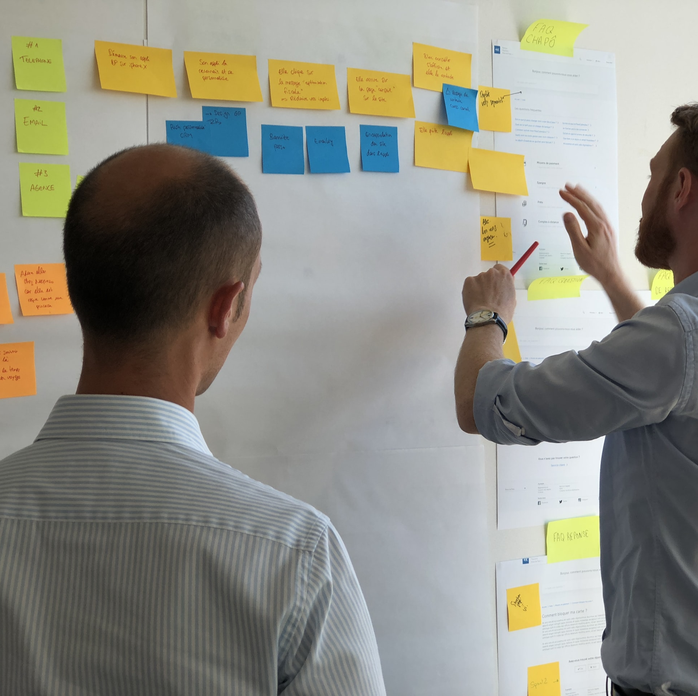
Common Elements
Meet with stakeholders
Develop a common language
Collect desired system behaviors that offer value
Document the desired behaviors
Iterate and refine!!
User stories are the least common denominator of most approaches
Notes:
Here are some things that these different methods have in common. Notice two important things: stakeholders and value <read slide>
The artifact produced by these common elements is user stories!

Slide 7
“Building the Right Thing” Necessarily involves Value Judgments
Right for whom?
Who benefits?
Limitations of budget/time/personnel
Competing/incompatible ideas about what's important
Competing/incompatible sets of Conditions of satisfactions (COSs)

Slide 8
Requirements Analysis connects High-Level Planning To User Stories
PEOPLE
PROCESSES
PROGRAMS
PLANNING
Requirements Analysis
user stories &
ORGANIZING
conditions of satisfaction
implementing
Notes:
This lecture is providing part of the bigger picture for the context of user stories in software engineering. Connecting user stories with conditions of satisfaction is how we organize our software engineering process — that’s central to what we’re doing in this class.
This lesson talks about how we decide what user stories to select as part of our planning. Our course staff will judge whether your essential conditions of satisfaction represent an MVP for your user story. But they mostly won’t be judging whether your user stories are user stories worth doing.
In other words, in the context of this class we mostly see it it as a technical decision about how to satisfy a user story — a complex technical decision that involves design, but a technical decision.
But in reality, who decides what actual software should get built, what user stories should get prioritized? How do they decide?
DISCUSS: Who do you think gets to decide what user stories actually get prioritized in practice?

Slide 9
User stories come from analyzing the user’s requirements
As a(n) active outdoor park-goer I want a safe way to fly through the air under a tree so that I can feel the wind in my hair
Notes:
A tool of software engineering that we’ll use centrally this semester is the user story — we’re talking about user stories at the first lecture, and we’ll be talking about user stories during presentations on the very last day of class. User stories are tools to help us do engineering instead of aimless programming — they keep our focus on people — and they’re tools for keeping groups of people focused on the same goals.
User stories are a way of capturing the user’s stated goals in a way that hopefully helps us build the right thing (the tire swing) — that’s the main topic for this lecture.

Slide 10
What are user stories?
…a least-common-denominator approach documenting the requirements of users when planning projects
…a tool for keeping large collaborative teams on the same page when organizing projects
…formulaic statements of this form:
As a <role> I want <capability> so that I can <get some benefit>
Notes:
Different organizations describe user stories differently, like how different codebases use different styles. Our course’s style of user story will always have a specific form:
As a <role> I want <capability> so that I can <get some benefit>

Slide 11
Components of a user story
As a(n) active outdoor park-goer I want a safe way to fly through the air under a tree so that I can feel the wind in my hair
As a <role> I want <capability> so that I can <get some benefit>
Notes:
User stories concentrate on the user and their interaction with the new system.
A user story is a short simple description of ONE thing that the user would like to do, written in the user's language. "Short and simple" means that it can fit on a 3x5” We'll say more about this later.
(Remember this picture, we’ll come back to it)

Slide 12
Roles: “who”
Think “Canvas roles”
Roles are positions or functions that people inhabit! The person is not you! It is the user, not customer
You may want to build software to develop skills, or to make a codebase more maintainable. That’s good, but it doesn’t fit as a user story.
User stories are for users in a specific role:
“As a web server…” is not a user story!
“As a human being…” is better, but that’s still not a role
“As a user…” is almost always a cop-out
As a <role> I want <capability> so that I can <get some benefit>
Notes:
Question: what are some of the roles you and I fill with respect to Northeastern’s registrar?
The person is not you: I know you’ve had teachers who have forgotten this in the context of education. College professors are notorious about forgetting this in the context of education; CS education Leigh Ann Delyser always threatened to make a t-shirt that said “I’m sorry, you’re not my target demographic” when computer science professors argued that how she wanted CS taught to novices didn’t meet the model of a CS student in the professor’s head (which was usually very much like them).
These are not called “customer” stories, they are “user stories”. You might develop software for a self-driving car, and your customer is Tesla. But your user is Tesla’s customer. User stories force both you and your customer to focus on your user, who is presumably the one who wants to extract value from your software
“Role” lets us distinguish between the different ways that our software might be used: Canvas is used by both instructors and students. However, there are even more roles, which have different capabilities: TAs can also view grades, but they can’t add new Tas. “Course observers” can see course content, but not grades, and are not enrolled in the class. There are quite a few different roles in Canvas, and maybe you can see how it would help to organize features in that way.
Also mention “promotion driven design” — the user story is not about building things because you want to or because it’s good for your career. Sometimes you build things because you want to or because it’s good for your career! But if engineering is about solving problems with technology, that’s not software engineering.

Slide 13
Capabilities: “what”
A capability is a specific thing I want to be able to do
Because we’re building software, this is usually an action we can provide by using software, otherwise let’s not build software
A capability relates to a role
“As a teacher at Northeastern, I want to be able to access a laser cutter so I can finish an art project” is not a good user story. (It is too general)
As a <role> I want <capability> so that I can <get some benefit>
Notes:
User stories describe the capabilities that your software should provide. How do we expect users to actually interact with our system, and what results should they see?
They do NOT directly describe the full behaviors of those capabilities. For example: Under what circumstances should this capability be provided? What should happen if it can’t be provided? These are details that will eventually need to be spelled out, but right now we want a bird's-eye view of the desired capabilities.
QUESTION: what are some ways that this user story can be fixed? (‘change the role to make sense’ is probably the easiest one, but maybe a teacher could get a benefit in their role as a teacher from access to a laser cutter?)

Slide 14
Capabilities: “what”
Think verb, not noun
A capability is not a product
“As a College Administrator, I want a web application that does <this> and <that> so that I can…” is not a user story!
Better: “I want to be able to see student’s grades” or “I want a way to track course enrollment over time”
This is easy to get wrong in practice! Sometimes you really want to build a tic-tac-toe game.
You’re supposed to ask, “do I even need to build this?”
As a <role> I want <capability> so that I can <get some benefit>
Notes:
A capability is not a feature: this can be tricky, because you often want to build a specific feature! But user stories invite you to step back and make sure you’re solving the right problem.
Another way of putting it is that good capabilities are more like verbs. The more your capability looks like a noun, the more likely you are to be assuming too many details of the what you want to build up-front. There’s a time for deciding specifically want to build, and we’ll get to it soon!
Many complaints about “AI getting shoved into something” can be interpreted as confusion between a capability or a feature and product: the product goal seemed to be wanting to build a thing, rather than having the focus being on the capability that the user wants.

Slide 15
Benefit: “why?”
Benefits are key for user stories actually focusing on what matters to the user.
If a specific feature doesn’t relate to the benefit…
…maybe that feature isn’t worth building.
…maybe that feature is part of a different user story. (Maybe we should prioritize that different user story instead?)
As a <role> I want <capability> so that I can <get some benefit>
Notes:
Why do we include the benefit? Because ultimately our goal with building software is presumably to deliver value – do something that helps some user accomplish some goal. That “something benefit” is really what the requirement is. The customer probably doesn’t care to define every possible output for their system for every possible input – instead they just want to tell you what they want to have happen, in language that is as close to their own as possible.

Slide 16
Properties of a good user story
short: fits on a 3x5 card
may have prerequisites
has conditions of satisfaction that expand on the details
satisfies the INVEST+E criteria (more on this later)

Slide 17
Examples of Good User Stories
As a College Administrator, I want to keep track of students, the courses they have taken, and the grades they received in those courses, so that I can advise them on their studies.
As a driver, I want to be able to report potholes to the city so that the town can more quickly act to keep me safe.
As a pedestrian, I want to be able to report potholes to the city so that drivers stop dangerously swerving onto the sidewalk when I’m walking.
As a card game enthusiast, I want to be able to play blackjack online so that I can…
Notes:
DISCUSSION:
The different roles of “driver” and “pedestrian” might lead to very different designs! (Why? Well, a pedestrian will have a much easier time safely stopping and accessing a phone app.)
DISCUSSION:
What are the different benefits someone might get in this user story? The benefit of “making social connections” versus the benefit of “making money” versus the benefit of “distracting myself while I’m on the subway” have very different implications for the product we might want to build!

Slide 18

Conditions of Satisfaction fill in details of the desired behavior
Each condition of satisfaction
Describes a testable behavior, from the user's point of view
Must have a priority
Should be numbered within its user story
There may be multiple options for filling in the details with conditions of satisfaction: this is a design problem!
Notes:
Conditions of satisfaction are, effectively, test cases – or templates for test cases. These kinds of tests are sometimes called “acceptance tests” because they constitute the end-user accepting that your software does what they want.
Example of multiple options: “As a social media user, I want to not have to see posts that are offensive so that I can be confident reading my account in public” — do we do this via algorithmic filtering/banning/deletion, or tagging posts with offensive material?

Slide 19
Conditions of Satisfaction have Priorities. User stories too!
Essential (E) means the project is useless without it.
Desirable (D) means the project is less usable without it, but it is still usable.
Extension (X) describes a CoS that may not be achievable within the scope of the project. These might be things you'd want "in the next version".
Prioritizing user stories is also a planning activity for complex projects that are constrained by resources (budget, time, personnel) and multiple (competing or incompatible) ideas about what’s important.
Notes:
COSs must be prioritized as Essential, Desirable or Extension.
(Sometimes user stories are also prioritized, but in the class project this semester, we’re not going to prioritize user stories in the same way.)

Slide 20
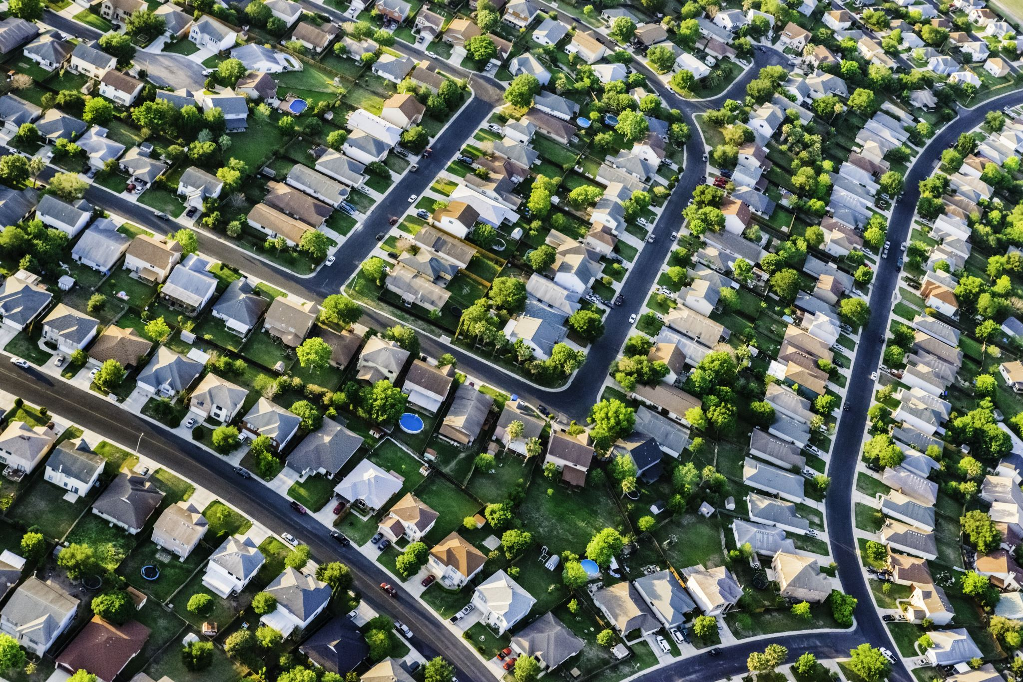
Worked Example: Pothole reporting system
A town is designing a system where citizens can a report potholes and the town can monitor progress on repairing them.

Slide 21
User Story #1
As a car commuter, I want to be able to report potholes to the city so that the town can more quickly act to keep me safe.

Slide 22
Conditions of Satisfaction
As a car commuter, I want to be able to report potholes to the city so that the town can more quickly act to keep me safe.
1.1 I should be able to report the location of a pothole to the system (E)
1.2 I should be able to see whether the pothole I report has been repaired (E)
1.3 I should be able to see whether others have reported potholes near me (D)
1.4 I should be able to see an estimated time when the pothole should be repaired (X)

Slide 23
User Story #2
As a pothole-repair-truck driver, I want the system to display the potholes I should be working on today, so that … (?)
Notes:
Q: What's the benefit here?

Slide 24
Conditions of Satisfaction
As a pothole-repair-truck driver, I want the system to display the potholes I should be working on today, so that I can view and report my progress for the day.
2.1 I should be able to see my list of potholes for today (E)
2.2 I should be able to report that I repaired a given pothole (E)
2.3 I should be able to report that I was unable to repair a given pothole, and to supply a reason (E)
2.4 My daily list of potholes should be listed in an order that cuts down the time I spend driving from job to job (D)

Slide 25
User Story #3
As a maintenance supervisor, I want to be able to control the order in which potholes are repaired, so that… (?)
Notes:
Maybe this is desirable, maybe it's essential.
Q: What's the benefit to the maintenance supervisor?

Slide 26
Conditions of Satisfaction
As a maintenance supervisor, I want to be able to control the order in which potholes are repaired, so that complaints to city hall are minimized.
3.1 I should be able to give a higher priority to potholes on a particular street (E)
3.2 I should be able to give a higher priority potholes in a particular neighborhood (E)
3.3 Anyone not a maintenance supervisor should not be able to change pothole priority (E)
3.4 I should be able to see on a map where there are a lot of potholes (D)
3.5 I should be able to see on a map which potholes that have been reported multiple times (D)
Notes:
Discussion: do these CoS pertain to the supervisor's desire to /control/ the order in which the potholes are repaired?
Prof. Wand says: these COS are about "planning" the order in which the potholes should be repaired, but it doesn't give him any _control_. If he wants to **control** the order, shouldn't there be a CoS something like "I should be able to assign each repair crew an individual set of potholes, and communicate this assignment to the crew"??

Slide 27
Writing User Stories: INVEST + E
Independent
Negotiable
Valuable (has value to client)
Estimable (able to estimate development effort)
Small
Testable
Ethical (connects with our & users’ values)
As a <role> I want <capability> so that I can <get some benefit>
Notes:
INVEST is a popular mnemonic for describing what makes a good user story (INVEST is widely used-- we've added the E because we think it's important)
Independent – Stories should not be coupled between each other, except where obviously necessary. Want to make it so that a user can examine a story on its own
Negotiable – Best stories are result of a negotiation between a client and a developer – how do we come to some mutual agreement about what we are going to build, and why? Goal is to develop what the customer needs
Valuable – Each story should have some benefit that the client can recognize. Value might include value to your business, not just value to the user.
Estimable (that is, estimatable) – As we will see in a bit, being able to estimate how long it will take to implement a user story is key to determining a reasonable scope for your project
Small – In the real world, a rule of thumb is to average 3-4 days of work per story for a full-time developer. For our projects, it might be something a single student might be able to accomplish in a week, along with their other obligations as a student.
Testable – There must be some way to judge completion: for the person implementing the software, and for the end-user.
These critera tell you whether a user story is good at the organizational level — whether it’s useful to organize a software project. “Good” here doesn’t mean that the user story is worth doing, or ethical
https://agileforall.com/new-to-agile-invest-in-good-user-stories/
… Let’s see an example and work through some of the tricky bits

Slide 28
User stories aren’t everything!
User stories roughly describe the functional requirements
The non-functional requirements are other properties that are also important to users and to other stakeholders
How quickly can a transcript be retrieved? (Performance)
How many student transcripts can our system store? (Scalability)
How much time do I spend on the phone with support to explain how to use the software? (Usability)
After my system is set up, is the access controlled at all? (Security)
Are these any times when I can’t use this system? (Availability)
How expensive will it be to adapt the system to new requirements? (Maintainability)
Notes:
What we've talked about so far are called "functional requirements"-- the minimum functions that a system must be able to perform.
But there are other kinds of requirements. These are called "non-functional" requirements.
Non-functional requirements capture the quality goals of a system.
Here are some obvious ones <read slide>

Slide 29
Other non-functional requirements
Availability
Capacity
Efficiency
Extensibility
Maintainability
Performance
Privacy
Response Time
Response Time
Scalability
Security
Supportability
Testability
Usability
Notes:
Organizing software engineering around functional requirements and user stories makes it important to not lose sight of non-functional requirements. These usually can’t be expressed well as user stories as we’ve strictly defined them (Discussion point for class: why? Often they violate the “the user is not you” requirement, but there are other good answers.)
Over-focusing on user stories and design requirements can be counterproductive in the long term! (Under-focusing on user stories and design requirements can be terrible for a hackathon)

Slide 30
Minimum Viable Product
Once you decide on a set of user stories, the Essential (E) conditions of satisfaction for those user stories constitute the minimum viable product (MVP)
A user story is "implemented " when all its essential COSs are implemented.
For the course project, the MVP is worth 8% of the course grade. Any desirable (or extension) features that your team delivers are worth up to an additional 4%.
So: when proposing a project, don't make your MVP too hard to complete (but don't make it too easy, either)
Notes:
The set of essential user stories constitutes the minimum viable product.
On the project you get 100 points for delivering your MVP (the selected user stories and their essential COSs). The remaining 50 points come from implementing the desirable conditions of satisfaction for your selected user stories.
OTOH, we will ask you to extend any project proposal that is too conservative.]

Slide 31
Review
At the end of this lesson, you should be able to
Explain the overall purposes of requirements analysis
Explain the connection between requirements analysis and user stories
Explain the structure of a user story
Identify and fix user stories that don’t have the correct structure
Define the relationship between conditions of satisfaction and user stories
Explain the difference between essential, desired, and extension levels of priority.
Explain the difference between functional and non-functional requirements, and give examples of each

